Slide 1
Warhorse (2011)

Slide 2
The harsh reality of War
The threat of death and devastation beckons just around the corner throughout Spielberg’s epic devotion horses who served during World War One in Warhorse (2011).
Horse lovers and viewers expecting a romantic film about a boy and his horse will be ambushed like that of the Prussian army during one of Spielberg’s chilling battle scenes. For the threat of war wages on the periphery throughout the film’s depiction of an unlikely colt who becomes a valuable asset for both sides in the trenches.

Slide 3
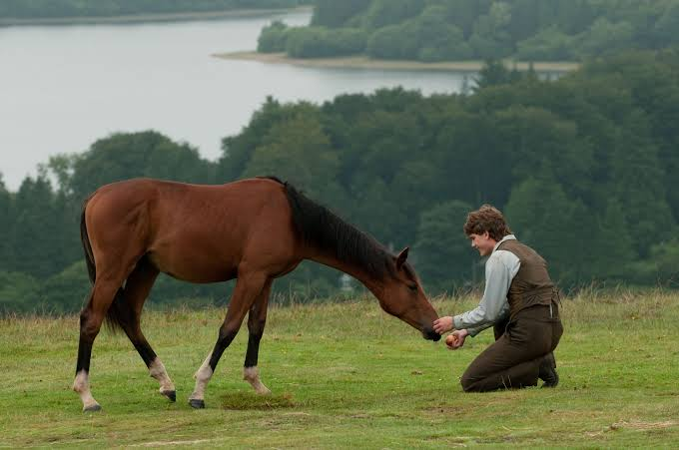

Slide 4
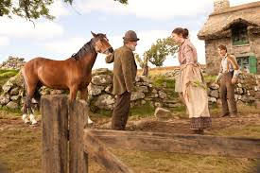

Slide 5
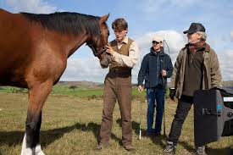

Slide 6
Joey’s road back home
Plot summary

Slide 7
Focus Sequence
Identify sequence
Write 300-400 analysis including technical and symbolic codes or 2-3 minute audio commentary.
Include screen shots of the sequence.

Slide 8
Who will enjoy this movie?
Social proof – reviews, reception and rotten tomatoes.
Who would you recommend the film to?

